Slide 1
Day 1/100 Java Practice
100 Days of Coding Practice
Navaneethan

Slide 2

Prg – 1: Welcome to Java!
Welcome to the world of Java! In this challenge, we practice printing to stdout.
Input Format
There is no input for this challenge
Output Format:
You must print two lines of output.
1. Print Hello World! on the first line
2. Print Hello Java! on the second line.

Slide 3
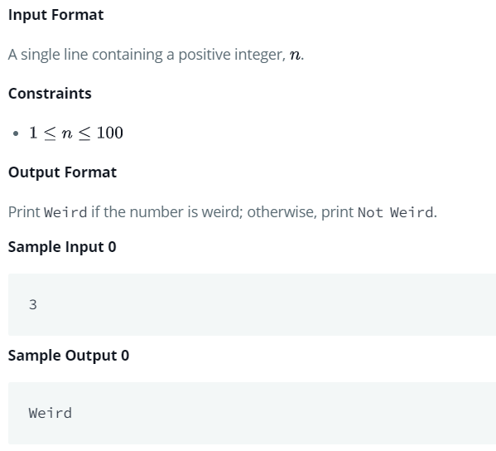
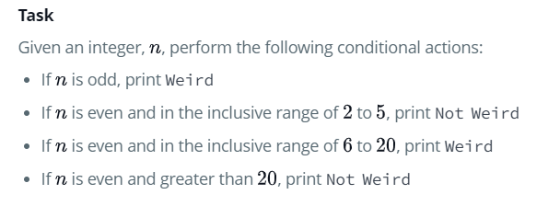
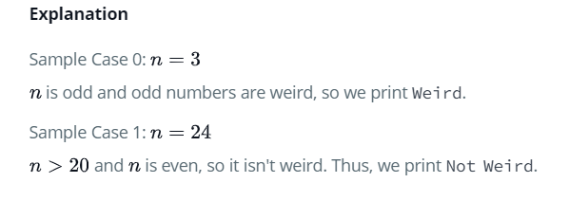
PRg – 2: ConditionaL CHECK
In this challenge, we test your knowledge of using if-else conditional statements to automate decision-making processes.
An if-else statement has the following logical flow:

Slide 4
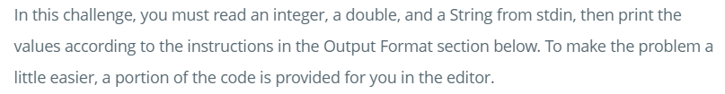
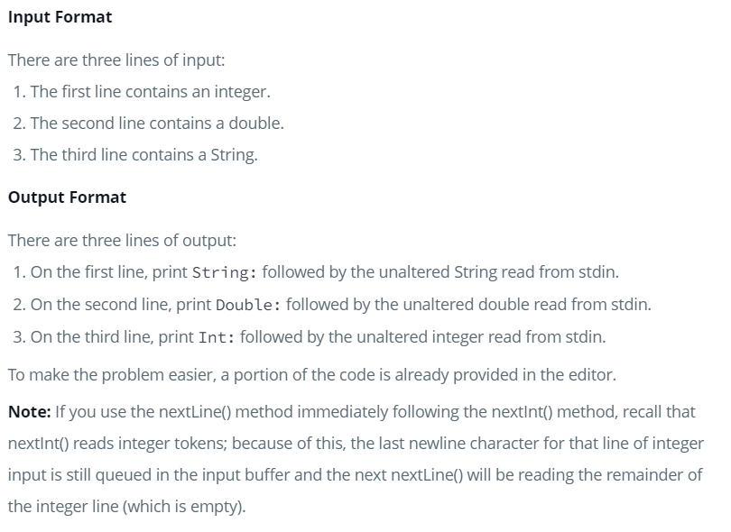
PRg – 3: java stdin and stdout
Sample Input:
42
3.1415
Happy learning..!
Sample Output:
String: Happy learning..!
Double: 3.1415
Int: 42

Slide 5
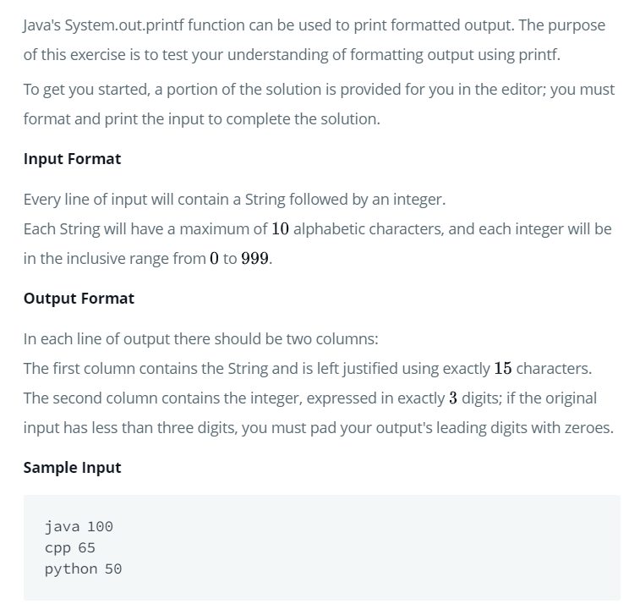
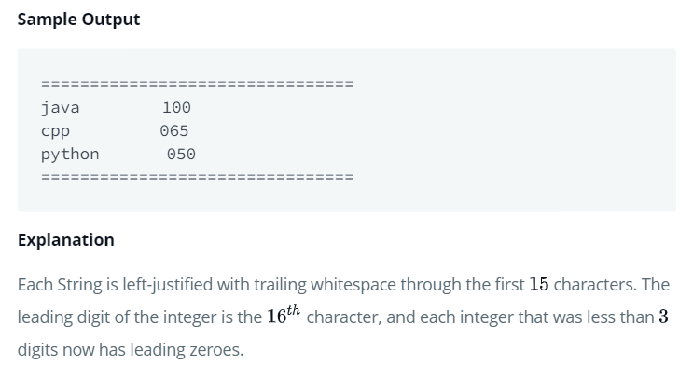
PRg – 4: java stdin and stdout

Slide 6
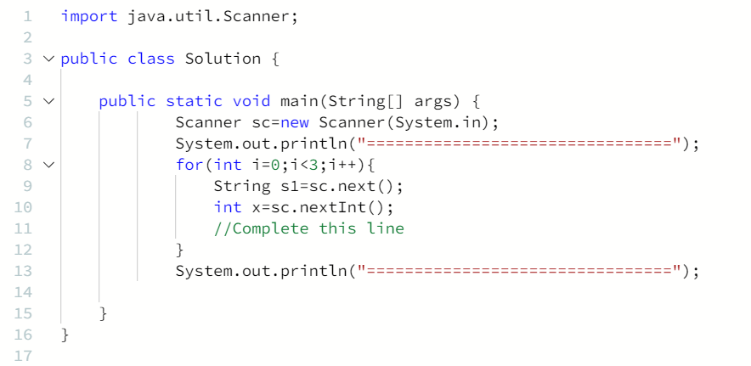
PRg – 4: java stdin and stdout
Code Snippet :

Slide 7
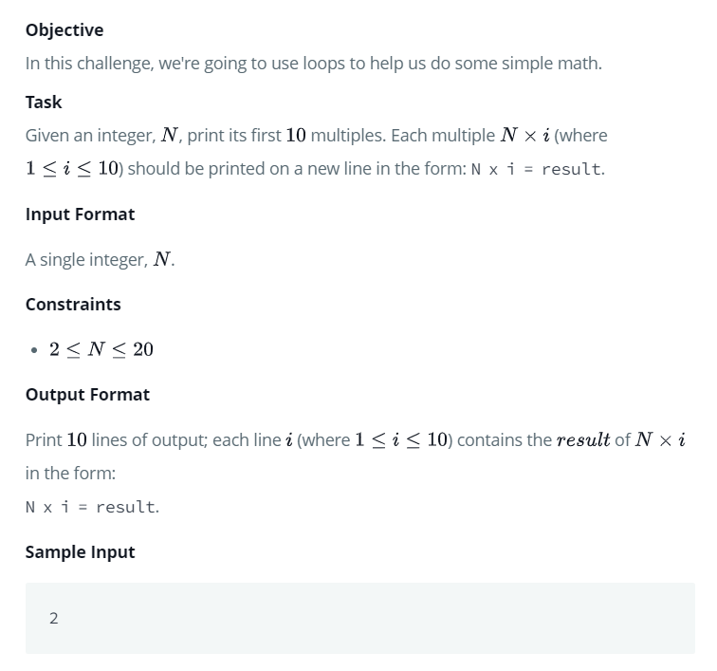
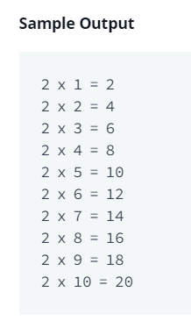
PRg – 5: java LOOPS

Slide 8


